Slide 1
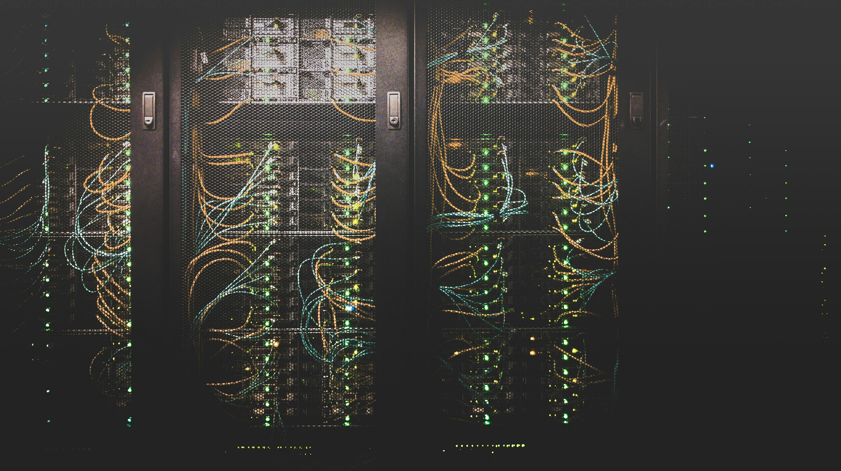

Data Center Waste Heat Reuse: Final Takeaways
Prepared for Microsoft
David Gardiner & Associates
October 2025

Slide 2

Table of Contents
Key Project Takeaways
Refreshers on key project components:
Proximity Analysis
Business Case Analysis
Food & Beverage Sector Interviews
Conclusions
Potential Next Steps

Slide 3
Key Project Takeaways
01

Slide 4
Key Takeaways
Key Takeaways
01
Heat reuse projects are feasible for Microsoft’s European data centers because:
Numerous promising offtakers in the food & beverage (F&B) sector are located within several kilometers of Microsoft sites. Many of these sites are large-scale.
Data centers could see payback periods of less than a year when implementing heat reuse. F&B offtaker facilities could see payback periods ranging from two to five years.
Leaders at major F&B companies, interviewed by DGA, expressed widespread enthusiasm about waste heat partnerships. The companies all have at least some processes that require heat in an optimal temperature range for heat reuse.

Slide 5
Refreshers on Key Analyses
02

Slide 6
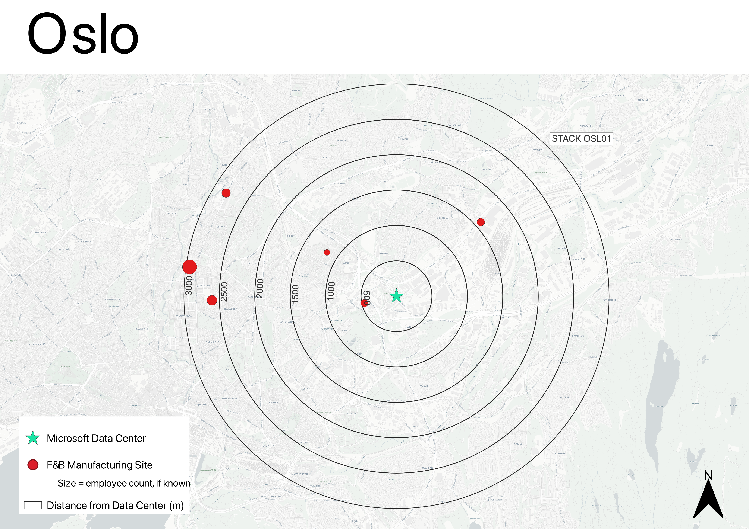
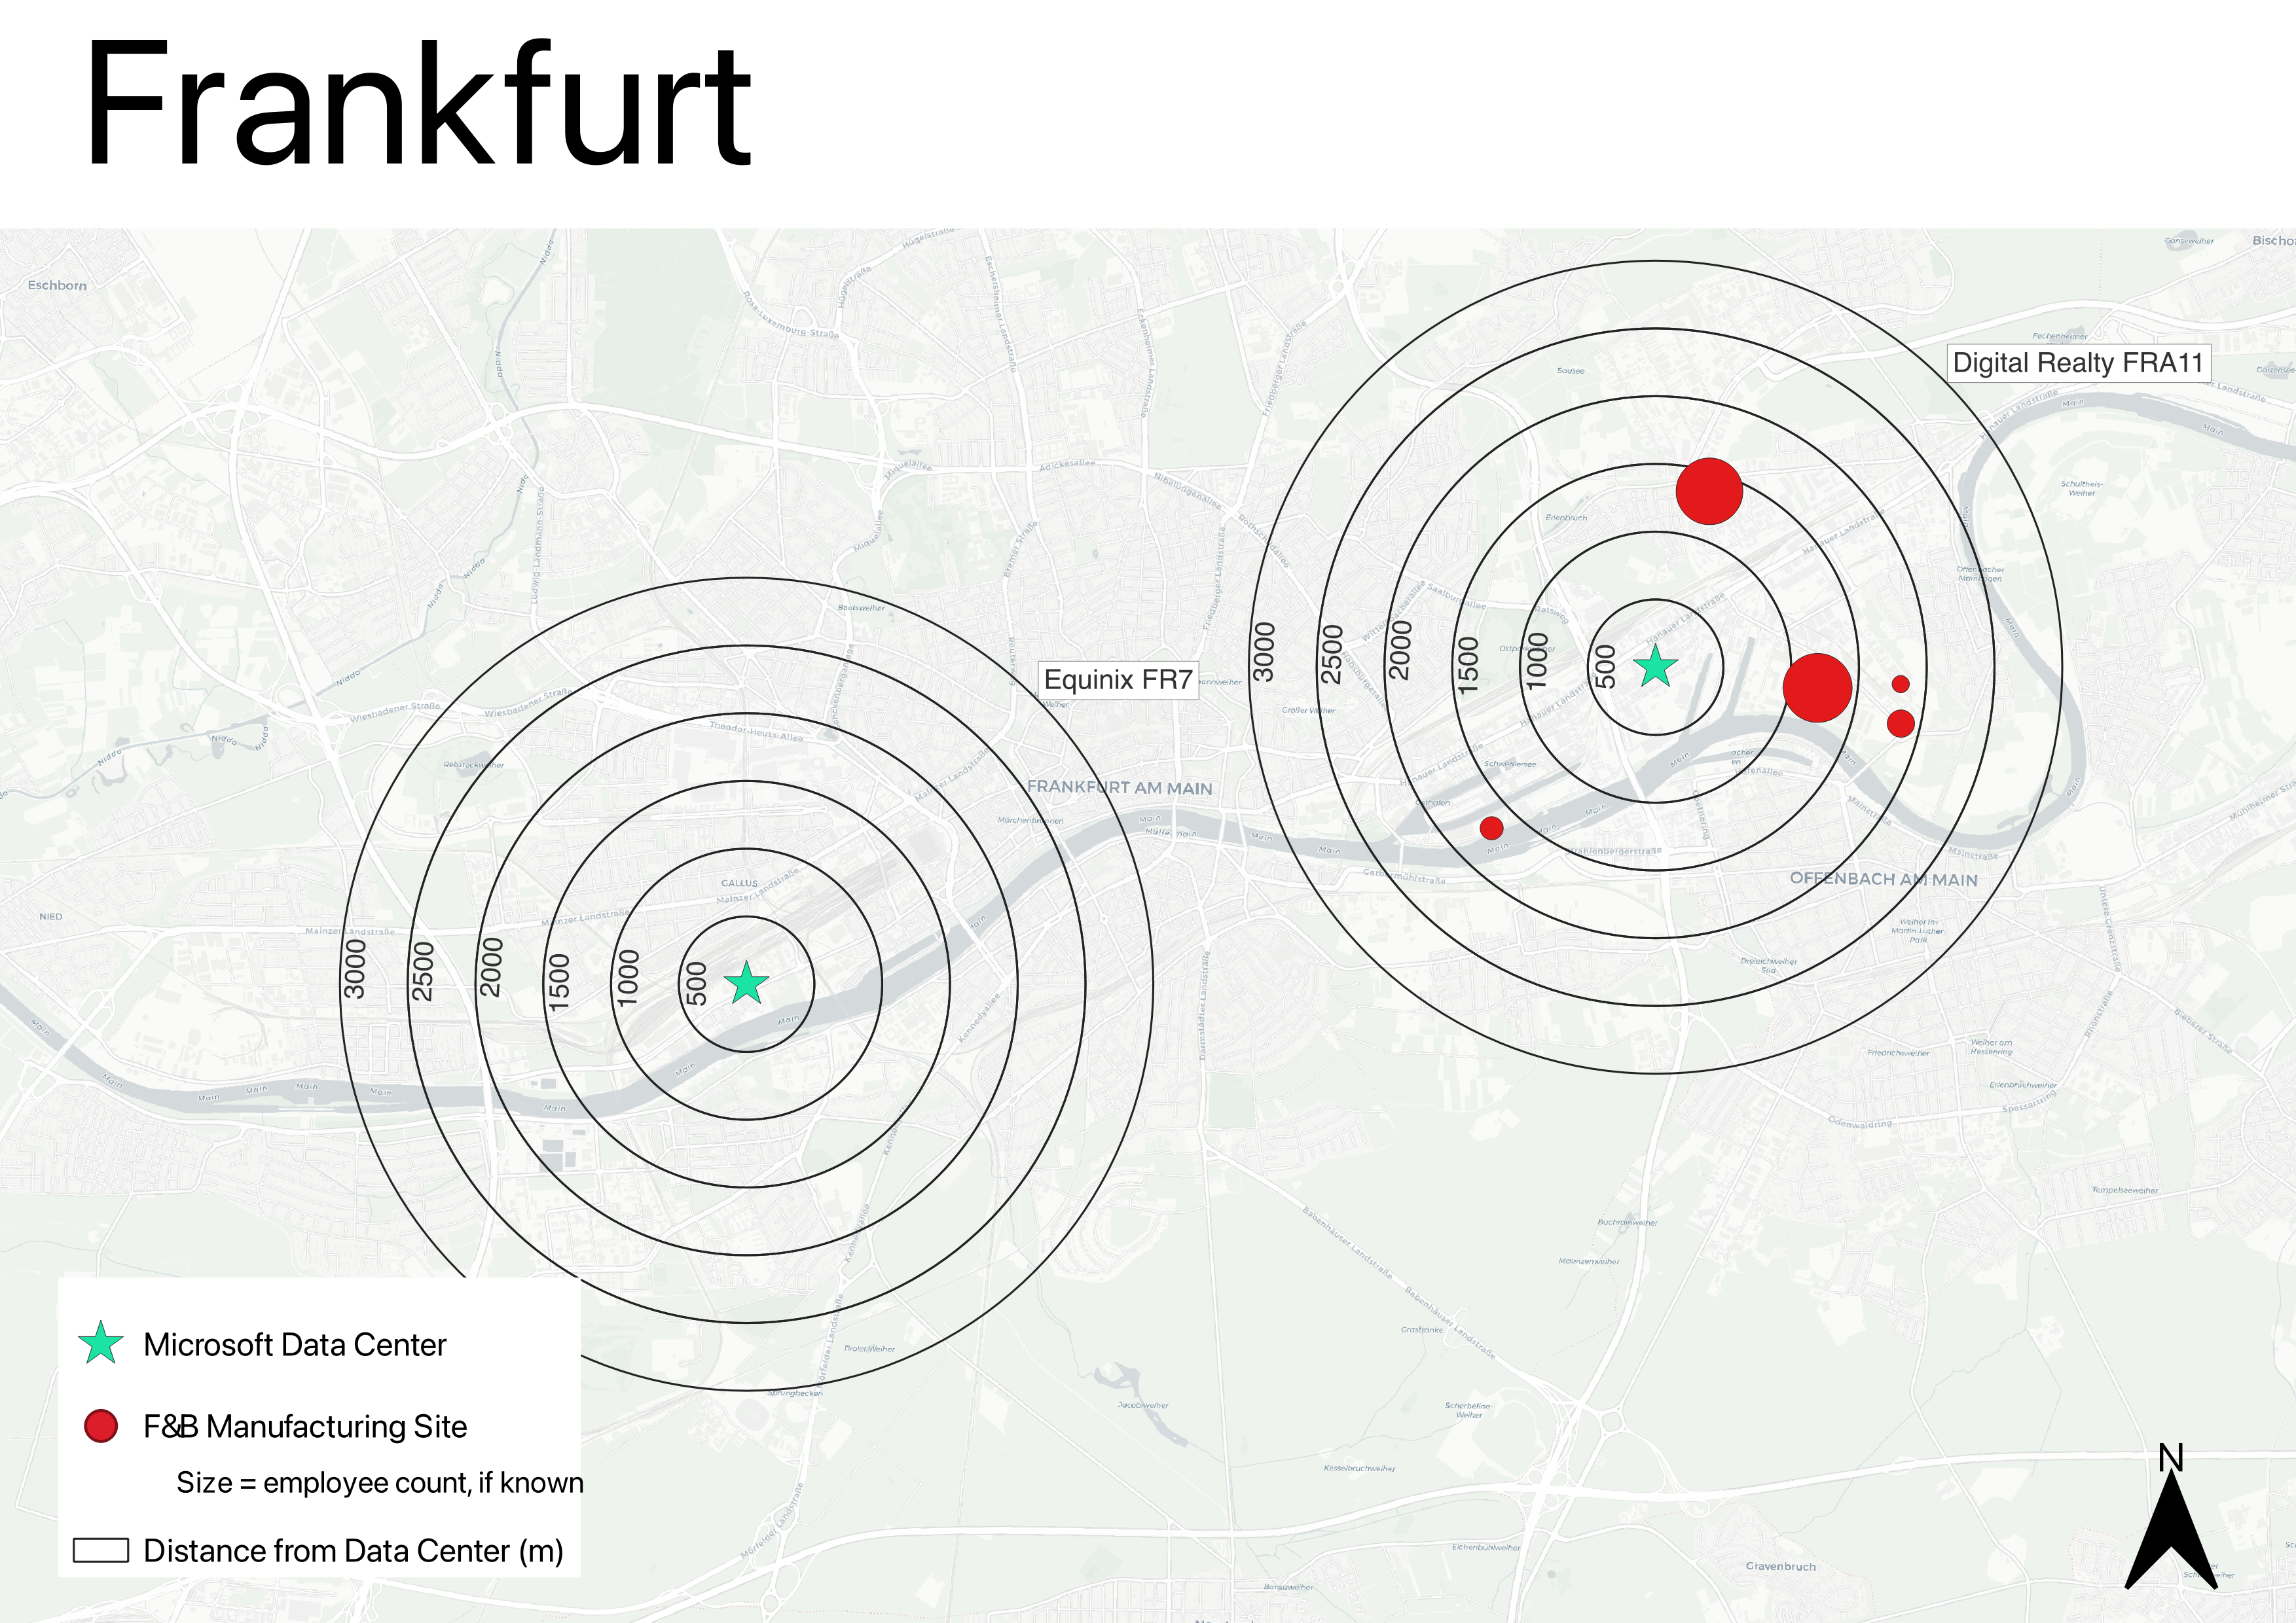
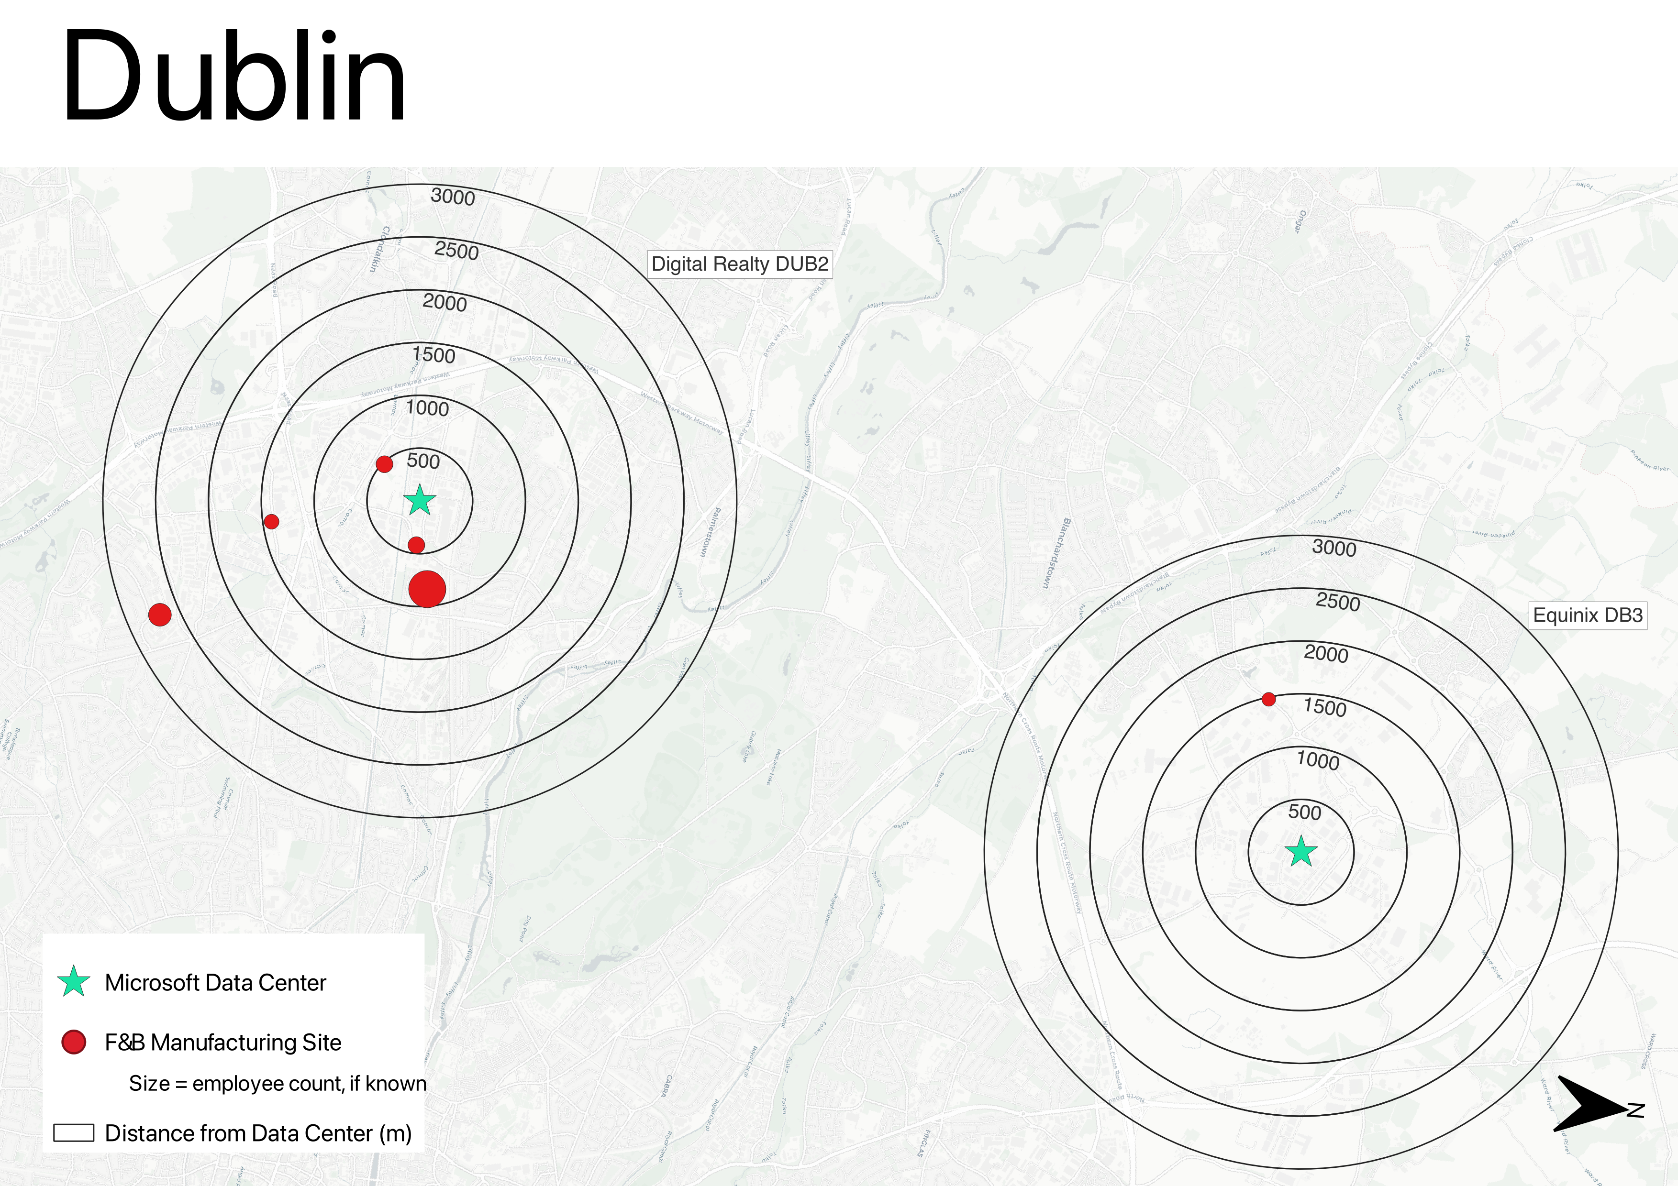
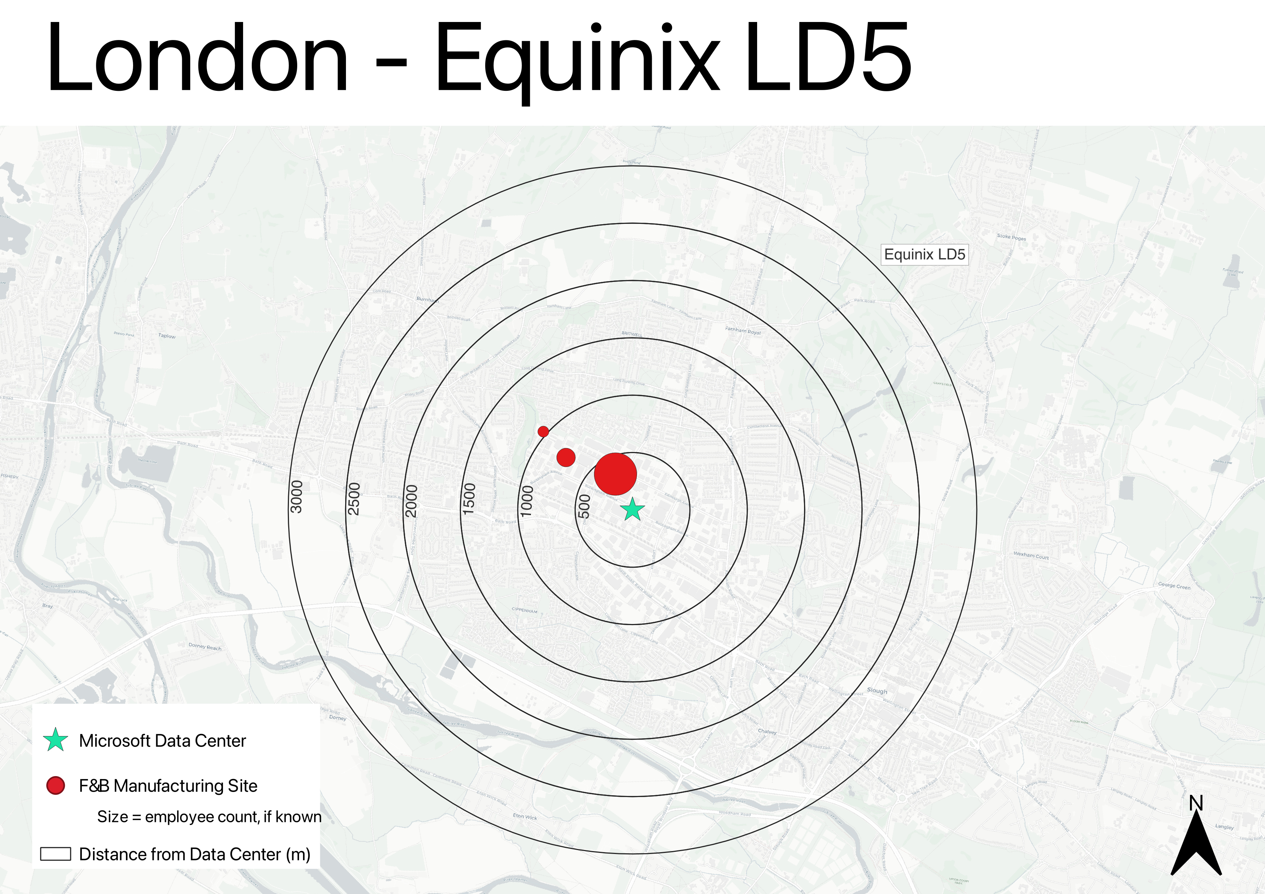
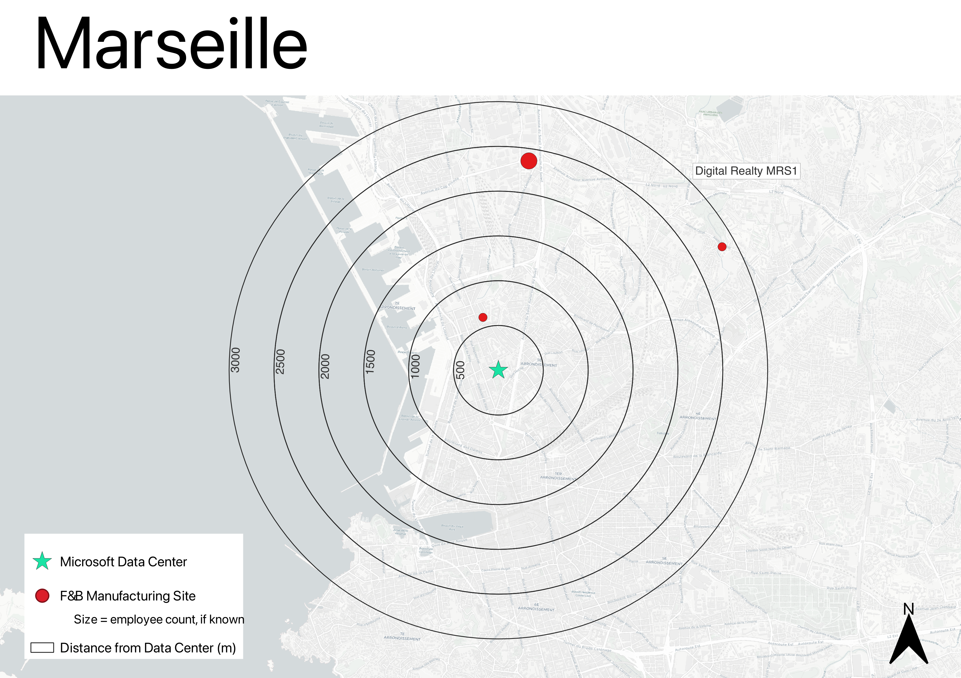
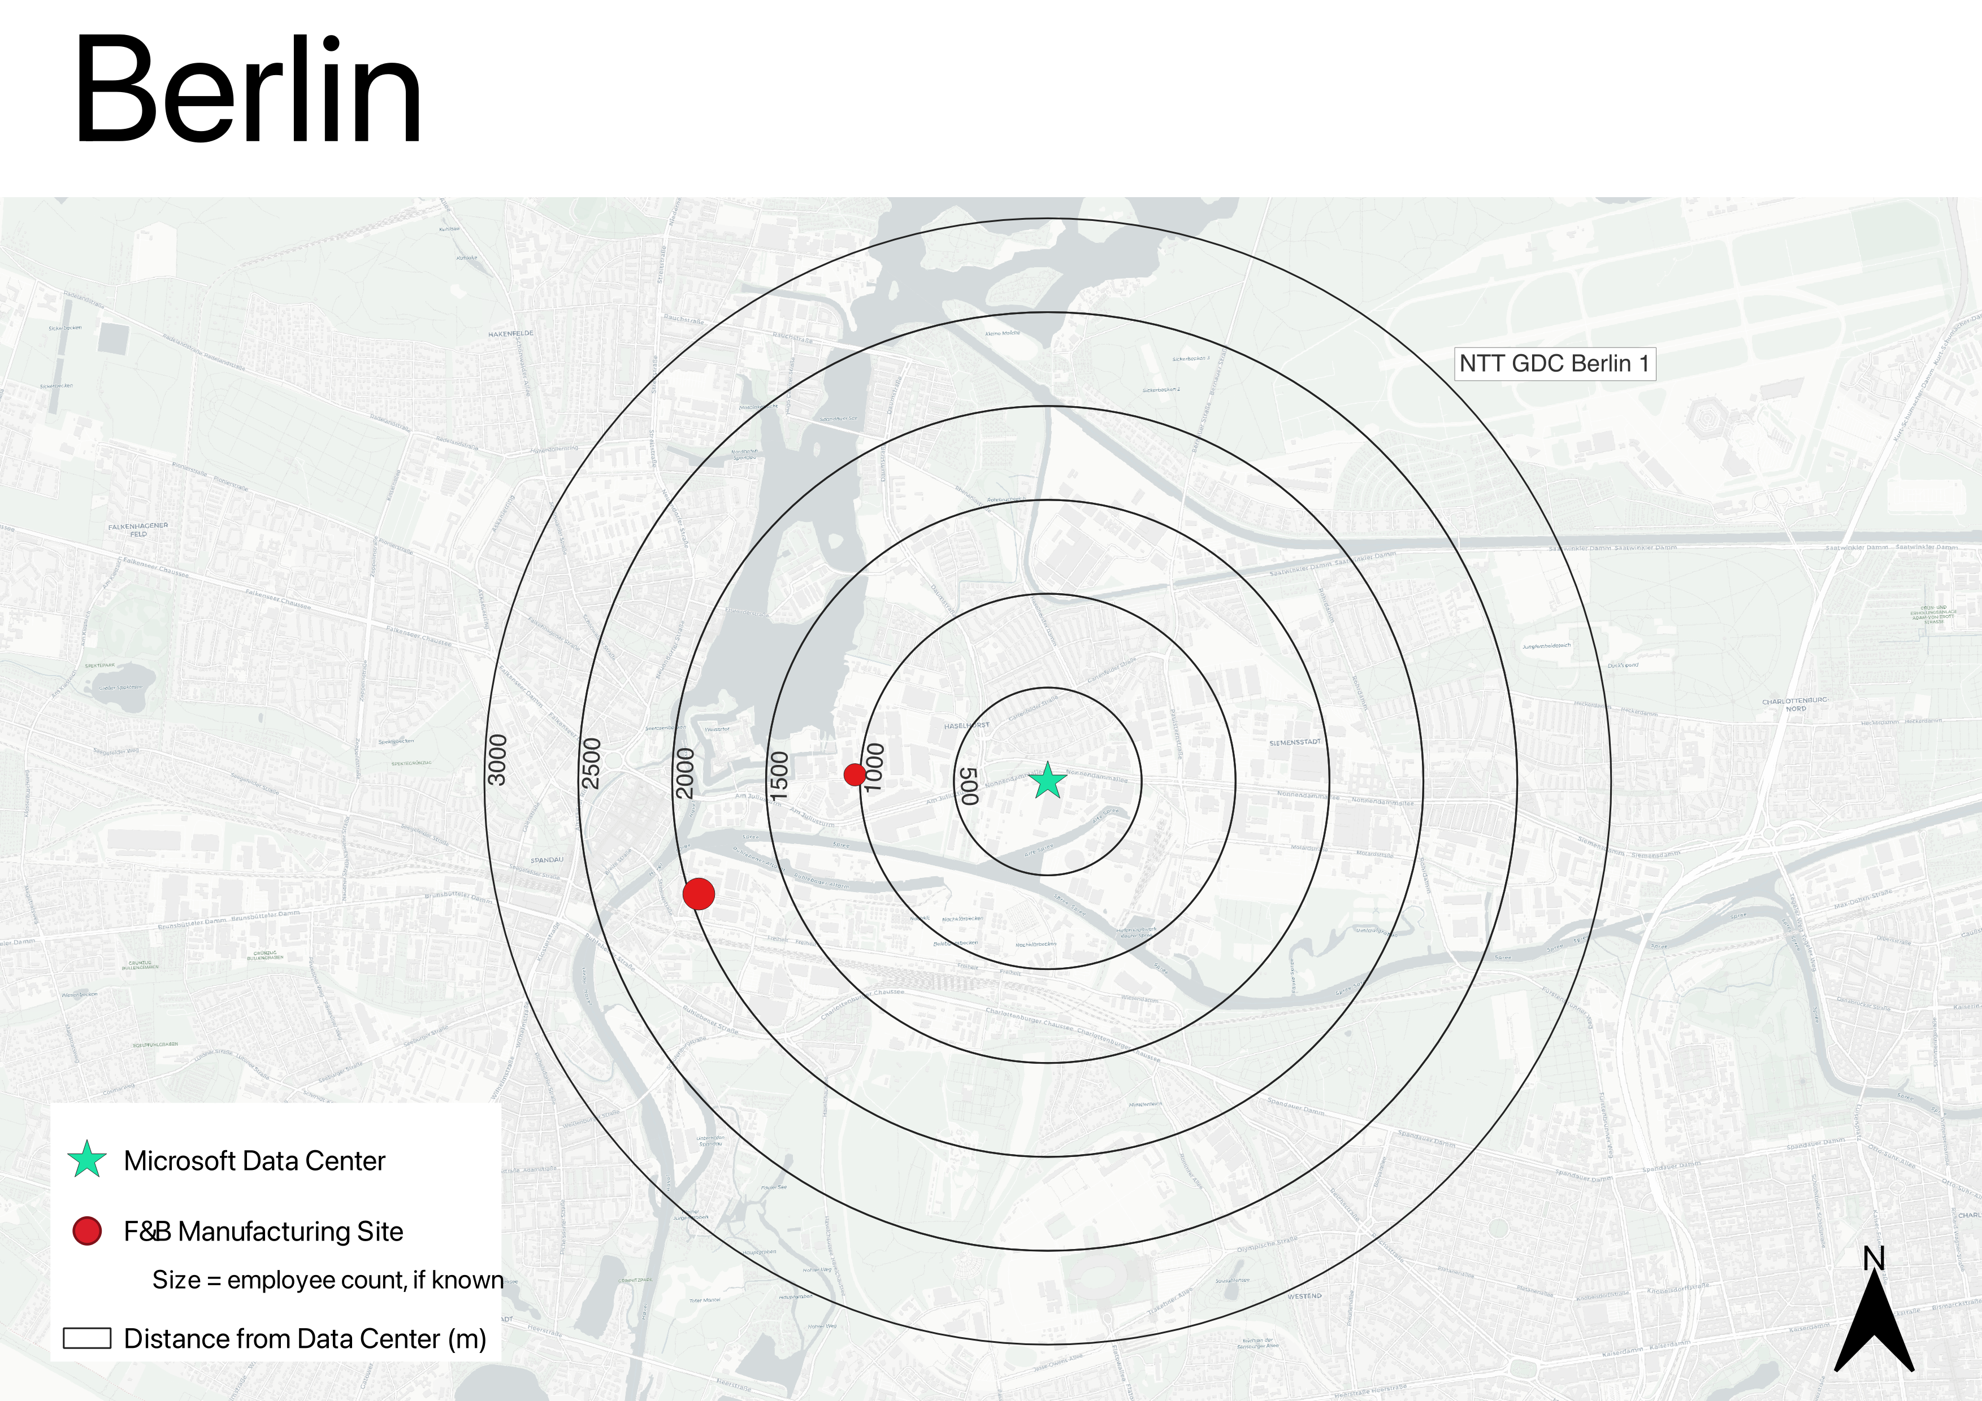
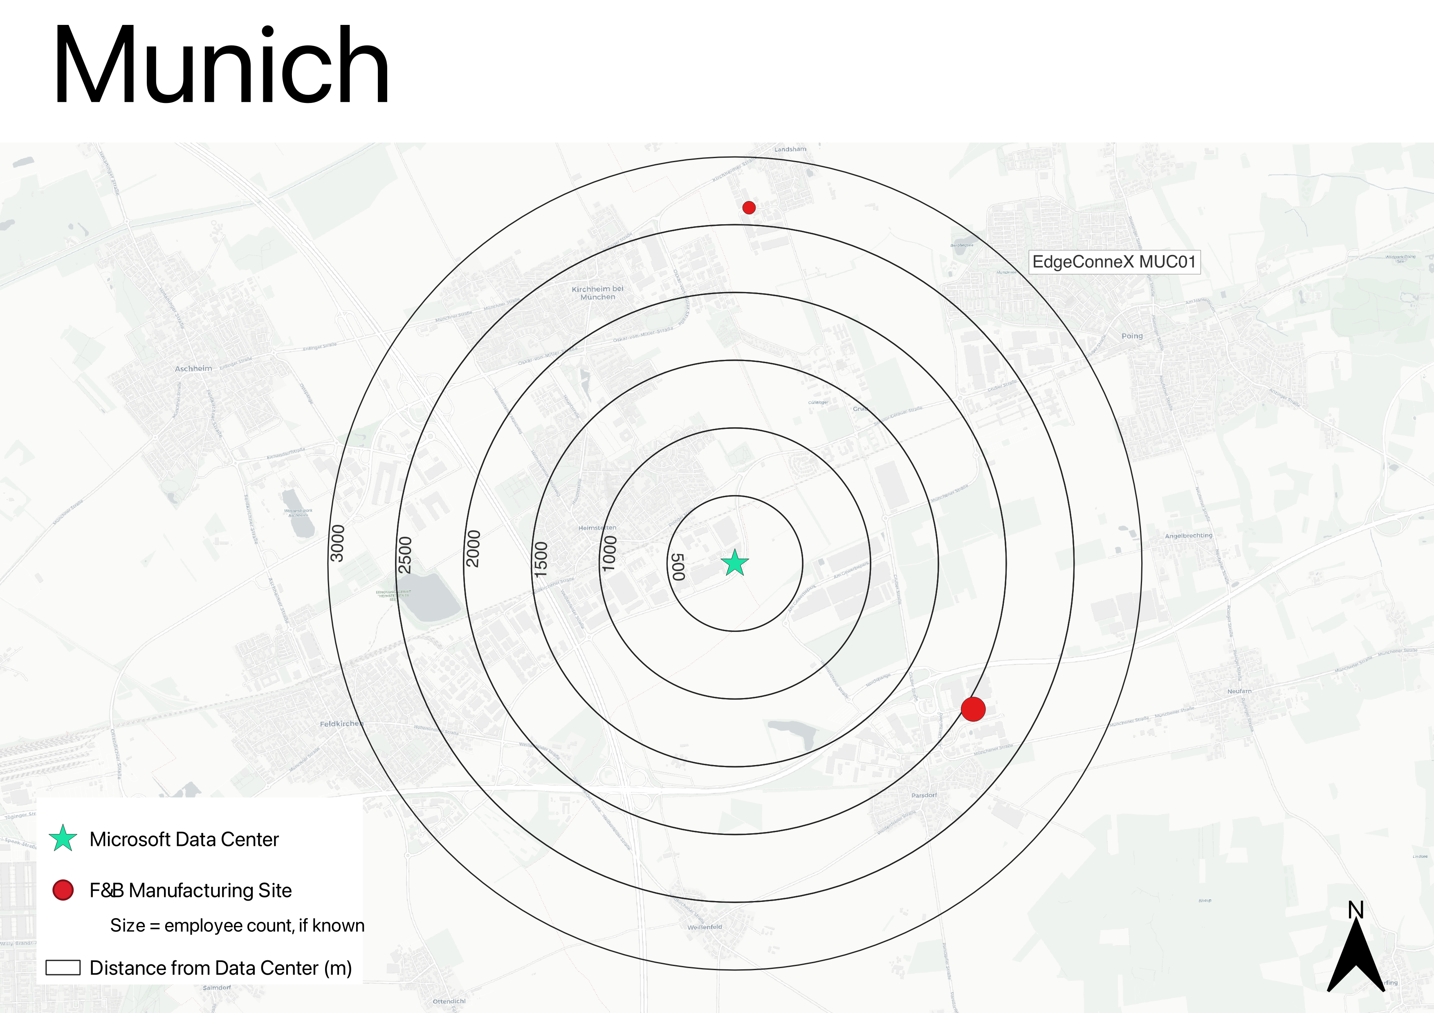
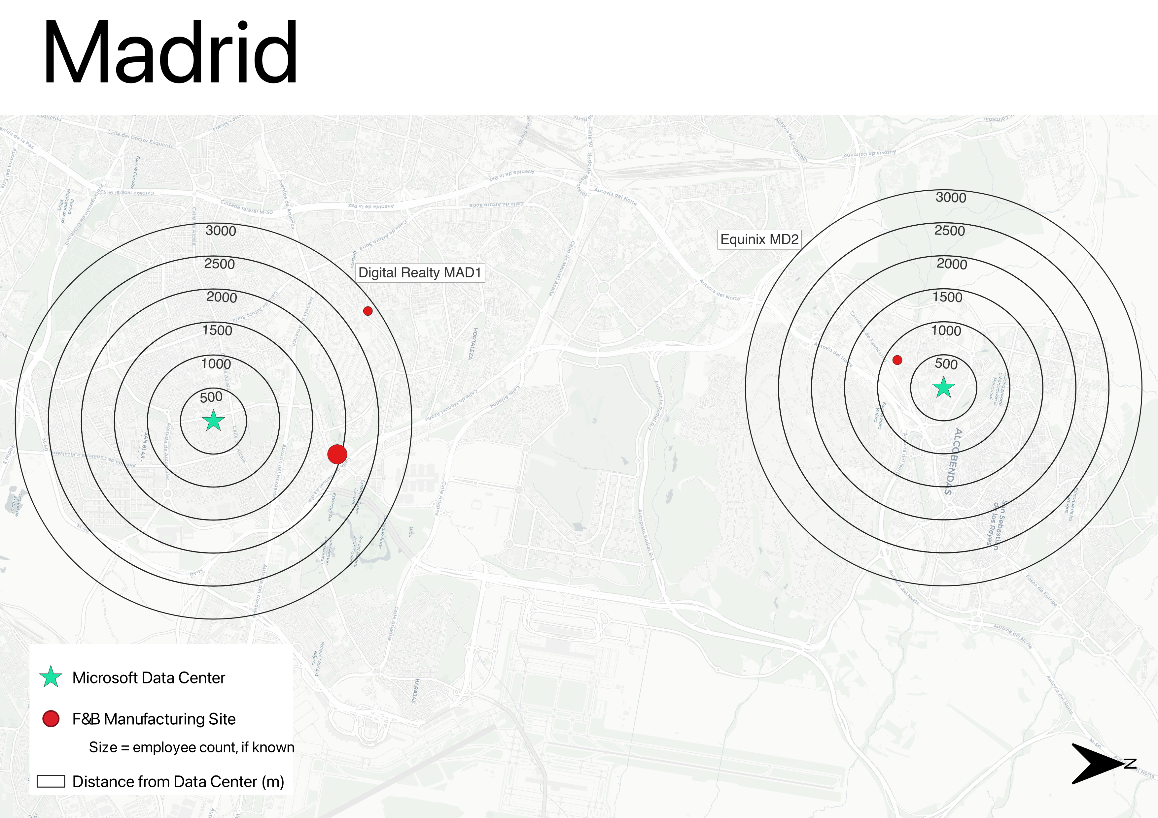
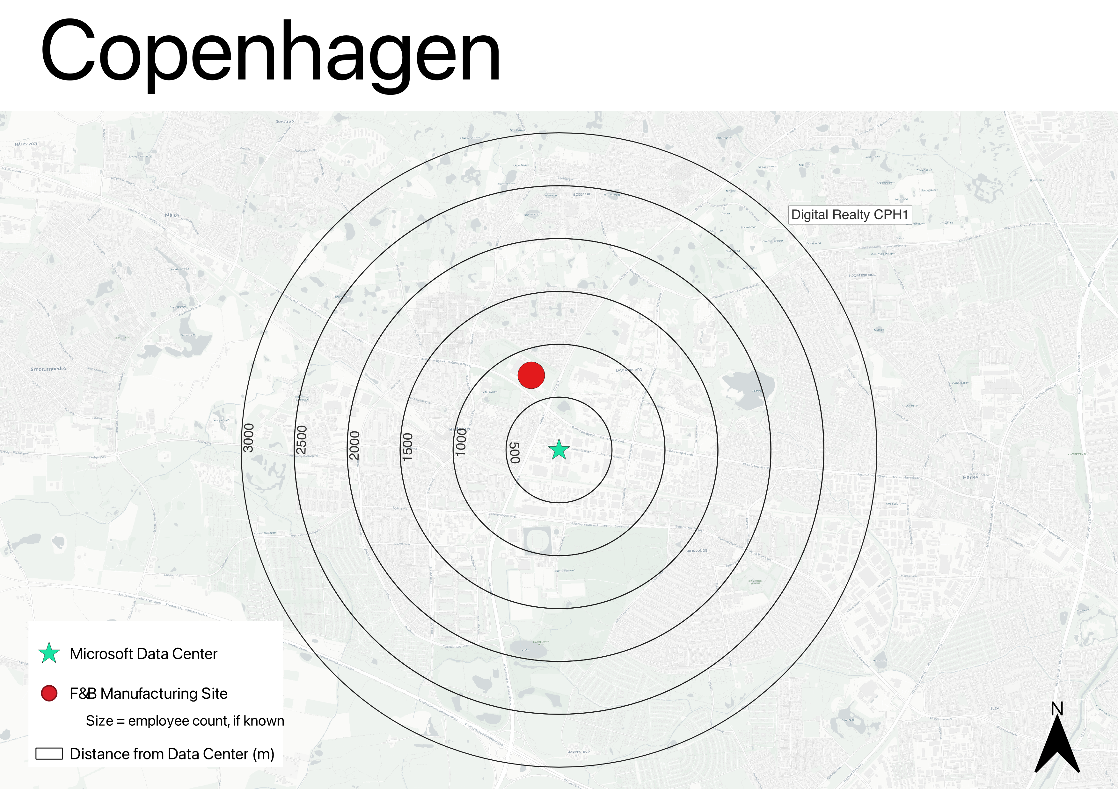
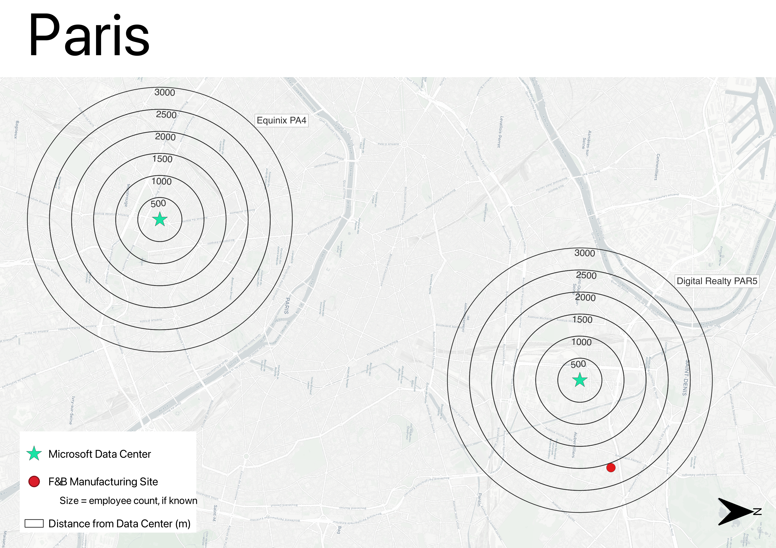
At least 33 food and beverage manufacturing facilities fall within three kilometers of a Microsoft Data Center in Europe.
Project Overview
Proximity Analysis
Oslo
Frankfurt
Dublin
London
Marseille
Berlin
Munich
Madrid
Copenhagen
Paris

Slide 7
Proximity Analysis
Out of 26 Microsoft data centers in Europe, 50% are within three kilometers of a food and beverage manufacturing site.
23% of data centers are within one kilometer of a manufacturing site. The average distance to the closest F&B manufacturing site is 3.43 km. All data centers are within ten kilometers of a manufacturing site.
Percentages shows the proportion of Microsoft data centers in Europe at the given distance from an F&B manufacturing site.

Slide 8
Numerous F&B facilities are within short distances of Microsoft Data Centers in Europe.
Project Overview
Proximity Analysis
Nine F&B facilities are less than one kilometer away.

Slide 9
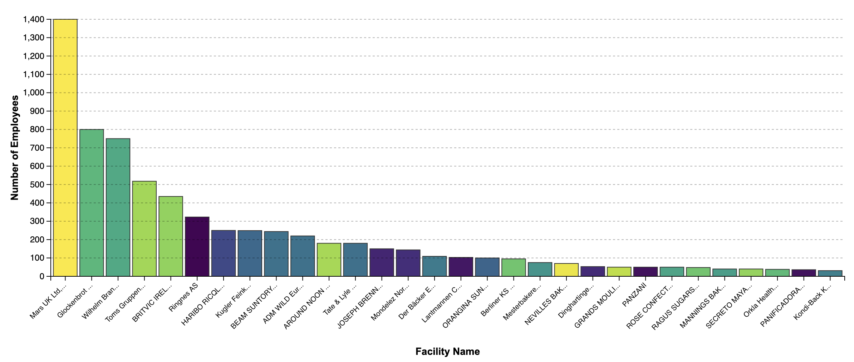

Proximity Analysis
F&B manufacturing facilities near data centers are industrial scale.
The median F&B manufacturing site within three kilometers of a Microsoft data center has 106 employees. A single facility owned by Mars, Inc., which is ~350 meters from the Equinix LD5 data center in London, employs 1400 people.
F&B manufacturing sites within 3 km of a data center
Distance to data center
345 m
2941 m

Slide 10
Business Case Analysis
Business case analysis proves heat reuse makes economic sense for both Microsoft and the potential heat offtakers.
Data centers could expect payback periods under 1 year, due to savings from avoided electricity use compared to necessary capex.
Offtaker payback periods varied considerably across five scenarios but should range from 2-5 years, depending on factors such as: technical set-up (e.g., # of heat pumps required, if any), local electric prices, avoided NG costs, carbon tax, and subsidies.
CAPEX and OPEX heat exchange room comparison.
Attribute | Heat Reuse Case | Heat Rejection Case (status quo) | Cost Savings
CAPEX | € 792,000 | € 10,450,000 | € 9,658,000
OPEX | € 220,000/yr | € 3,170,000/yr | € 1.2-3.0M/yr

Slide 11
Business Case Analysis
Case Study Overview
Selecting potential offtakers for each case began with a list of F&B facilities within 3 km of Microsoft data centers (identified by the Proximity Analysis).
Since each manufacturing facility’s thermal energy needs are not known, the analysis estimated sites’ thermal demands based on their F&B subsector and the size of facility, measured by its number of employees.
01
Manufacturing sites near Microsoft data centers with the greatest estimated thermal energy needs
Facility | Distance to data center (km) | # of Employees | NACE Activity Name | Thermal Energy Needs (ranking)
RAGUS SUGARS (MANUFACTURING) LIMITED | 1.034 | 48 | Manufacture of sugar | 1
BEAM SUNTORY SPAIN SL. | 1.948 | 244 | Distilling, rectifying and blending of spirits | 2
R & A Bailey & Company | 0.481 | 130 | Distilling, rectifying and blending of spirits | 2
Premier Foods Group Ltd, Rogerstone Park Food Factory | 6.086 | 850 | Production of meat and poultry meat products | 3
Wilhelm Brandenburg GmbH & Co. oHG | 1.357 | 750 | Production of meat and poultry meat products | 3

Slide 12

Business Case Analysis
Germany (Frankfurt)
F&B Facility: Wilhelm Brandenburg GmbH & Co (Meat Processing)
01
Facility Info
Distance to data center: 1.56 km
Data center output temperature: 30°C
Facility use temperature: 80°C
Financials
CAPEX (including subsidy): €10.5M
Payback period: 3.1 years
Subsidies Available
CAPEX subsidy for large-scale heat pumps can cover up to 50% of the installation cost.
Key Characteristics
The German Energy Efficiency Act, which makes heat recovery mandatory.
Wilhelm Brandenburg is a large-scale meat producer with a substantial and consistent thermal energy demand.
High consumer focus on sustainability in Germany creates a strong market and public relations case for this project.

Slide 13

Case Studies
Business Case Analysis
United Kingdom (Newport)
F&B Facility: Unilever Foods (Processed Food)
01
Facility Info
Distance to data center: 15 km
Data center output temperature: 65°C
Facility use temperature: 80°C
Financials
CAPEX (including subsidy): €10.0M
Payback period: 2.2 years
Subsidies Available
Financial support in the UK is limited. The primary incentive identified is a £7,500 guaranteed grant per heat pump.
Key Characteristics
The long distance (15 km) demonstrates the feasibility of heat reuse even when the off-taker is not immediately adjacent.
This high performing compute data center significantly improves the financial case by reducing the need for extensive temperature lifting with heat pumps.

Slide 14
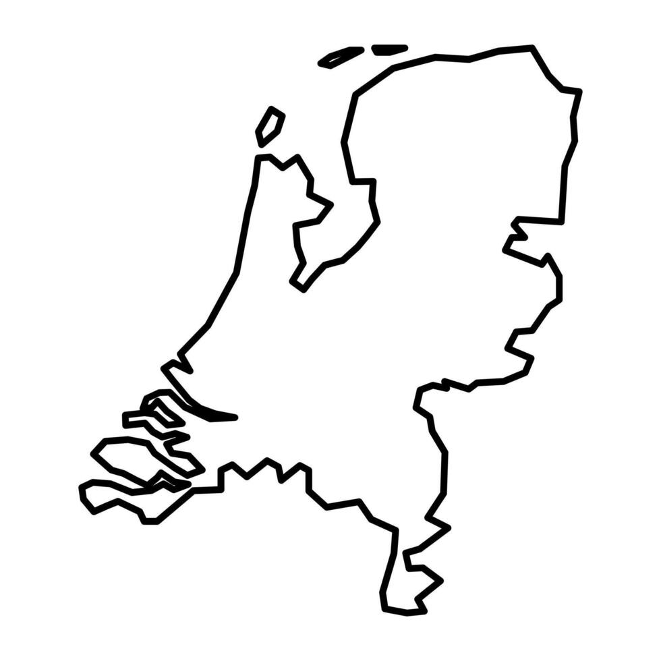
The Netherlands (Agriport A7)
F&B Facility: Horticulture (Greenhouses)
Case Studies
Business Case Analysis
01
Facility Info
Distance to data center: 1.0 km
Data center output temperature: 55°C
Facility use temperature: 55°C
Financials
CAPEX: very low due to use of low-temp heat
Payback period: N/A
Subsidies Available
The SDE++ subsidy is a significant opportunity, offering up to €400 / ton CO₂ for waste heat projects.
Key Characteristics
Data center heat is supplied to nearby greenhouses.
The optimal temperature is a blend of waste streams to achieve 55°C, avoiding the need for heat pumps and preventing wasteful use of high-grade heat.
The business case here is driven less by direct profit and more about sustainability, community relations, and securing building permits for future expansion.
Costs are minimal due to the use of low-temp heat, which avoids the need for heat pumps and complex offtaker routings.

Slide 15
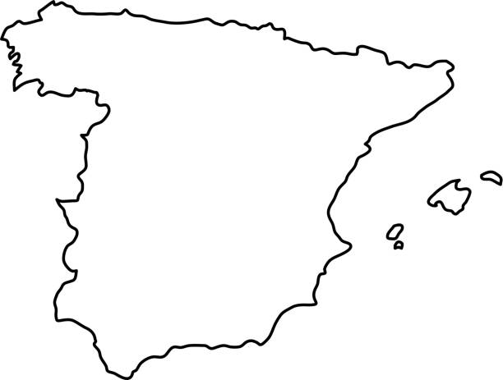
Case Studies
Business Case Analysis
Spain (Zaragoza)
F&B Facility: La Zaragozana (Brewery)
Facility Info
Distance to data center: 3.0 km
Data center output temperature: 30°C
Facility use temperature: 80°C
Financials
CAPEX (including subsidy): €5.6M
Payback period: 3.6 years
Subsidies Available
The IDAE provides CAPEX subsidies of up to 50% for large-scale industrial heat pumps (35% for the pump, 15% for installation).
Key Characteristics
Zaragoza is an emerging data center hub with a strong F&B sector.
Partnering with an iconic, recognizable brand like La Zaragozana offers significant public relations value.
There is a promising future opportunity with the planned CLAVE agri-food tech zone and the massive Costa Group meat complex.

Slide 16

Case Studies
Sweden (Staffanstorp)
F&B Facility: Oatly (Oat Milk Production)
Business Case Analysis
01
Facility Info
Distance to data center: 30 km
Data center output temperature: 30°C
Facility use temperature: 80°C
Financials
CAPEX (not including subsidies): €19M
Payback period: N/A
Subsidies Available
CAPEX support is available from the Swedish Energy Agency and EU programs.
For OPEX, EU ETS applies for large-scale DC.
Key Characteristics
This extremely long distance (30 km) pushes the boundaries of what is typically considered for heat reuse. (Other F&B industries are nearer.)
The partnership with a highly sustainability-focused global brand aligns with with Microsoft's CSR goals.
Because Sweden already uses waste heat, biofuels, and electricity for their heat needs, this case assumes data center heat would not offset gas use.

Slide 17
F&B Interviews
F&B Offtaker Interview Takeaways
DGA interviewed seven leading F&B companies. Takeaways cover heat compatibility, technical readiness, financial considerations, and interest in pursuing projects.
01
Interview Takeaways: Heat Compatibility
All companies interviewed had at least some heat needs in the optimal 60-100 degree Celsius range for a waste heat partnership. The most common applications include:
Cleaning
Process heating
Pasteurization
Feeding water in an existing loop

Slide 18
Overview of Interviewed Companies
F&B Interviews
Company | Temperature Needs | Heat Range Demand | Geographic Spread
Company A | 60-100°C for most processes (including industrial hot water); 80-130°C for some higher temperature food processes like drying | 1.2 TWh/year, with 60% from thermal | 35 facilities throughout the EU
Company B | A “large need” for “low-temperature heat,” below 93°C at protein sites as well as higher 93-149°C uses | Up to 300 MW thermal load | Netherlands, Germany, France, Italy, Spain
Company C | 60°C for pet food; 90°C for human food; up to 180°C for drying | 400,000-700,000 GJ of heat per ton/year | Germany (7), France (4), Netherlands (1), Italy (1)
Company D | 90°C for beverage steam pasteurization; 200°C for processes like frying | 18-24 MW per facility | Portugal, Spain, Belgium, Poland, UK
Company E | 80-90°C for process heat; 150°C for frying; 150-175°C for steaming canned foods | Moderate industrial scale | Czech Republic, France, Germany, Netherlands, Poland, UK
Company F | 60-80°C for low heat; 150-200°C for high heat | 1,000-100,000 GJ per site | Geneva, Zurich, Netherlands, Spain, Italy, UK, Germany
Company G | Can use 30-50°C heat for pre-heating water; 90-140° for cleaning and processing | 30-60 million kWh of natural gas | Sweden, Netherlands

Slide 19
F&B Interviews
Interview Takeaways: Technical Readiness
01
All seven interviewed companies are using at least one heat pump (full deployment or pilot).
Company D said: the more energy you can bring into the system, the less work the heat pump has to do.
Company F has established a cooling loop at some European sites.
Company G has a “standard heat recovery” system that it builds into all new facilities, and it is exploring retrofits of older sites.
Company E is accepting waste heat from two external partners.

Slide 20
F&B Interviews
Interview Takeaways: Financial Considerations
01
Most interviewed companies prefer a strict 2-3 payback period for capital projects, but more than one said timelines could be flexible for projects with climate benefits.
Two companies expressed interest in utility/energy-as-a-service models.
One company strongly expressed it would not want to pay a fee for the waste heat.

Slide 21
F&B Interviews
Interview Takeaways: Interest in Projects
Overall, companies were very interested in waste heat possibilities:
Company F: If there is a conveniently located data center, that is “definitely an interest to see if we can use this waste heat between neighbors.”
Company B: Efficiency is “in our DNA”; looking for “dark horse” solutions like heat reuse which might make a big difference but aren’t widespread yet.
Company D: Could either pursue a smaller proof-of-concept project or move directly to bigger project, depending on interest and feasibility.
Two companies said a next step would be to sign NDAs with Microsoft and discuss further.
Companies raised questions such as:
Reliability of waste heat supply, i.e., would the company still need boilers as a backup?
Expected payback period
Would the heat itself be free?
Water quality concerns
01

Slide 22
Conclusions & Potential Next Steps
03

Slide 23
Conclusions & Next Steps
Conclusions
01
Several opportunities for waste heat reuse exist across Microsoft's European data center portfolio. A significant number of large-scale, industrial food and beverage manufacturers are located in close proximity to existing data centers.
The business case is strong for both Microsoft and heat offtakers. Reuse projects can rapidly payback for data centers (potentially under one year) and for F&B partners (typically 2-5 years), which meets the investment criteria of many companies.
Potential F&B partners are enthusiastic, technically ready, and strategically aligned. Major F&B companies confirmed are already deploying heat pumps, require heat in the optimal range for reuse, and are open to flexible payback periods for projects with climate benefits.

Slide 24
Conclusions & Next Steps
Potential Next Steps
01
Explore potential partnerships by:
Facilitating connections and discussions with potential partners from the Food & Beverage interviews or the proximity analysis.
Outlining partnership models that would avoid Microsoft acting as a heat utility.
Expand data center waste heat reuse analysis to include:
Additional heat offtaker sectors such as pharmaceuticals or industrial facilities using low temperature heat.
Proximity analysis of facilities within 30 km of a Microsoft data center.
Geographies outside of Europe.
Exploration of the potential heat supply and demand loads in certain hubs or regions.
Payback period estimates at a range of temperatures, such as 45 deg C.
Fully incorporated costs and benefits to both the data center and the heat offtaker in each scenario.

Slide 25

Thank You
Contact:
David Gardiner (david@dgardiner.com)

